Slide 1
Workshop
All there is to know about python

Slide 2
What is PROGRAMMING
Programming is the implementation of logic to facilitate specified computing operations and functionality.
Programming language semantics and syntax are used when constructing an application. Thus, programming requires knowledge of application domains, algorithms and programming language expertise.
Programming language logic differs by developer. From a high level, good code can be evaluated with factors such as:
Robustness: Focuses on program continuation capability, regardless of errors or incorrect data
Reliability: Focuses on correct design and algorithm implementation
Efficiency: Focuses on memory, hardware or other properties used to optimize programs
Readability: Proper documentation and indentation availability, which provides insight to other program developers or designers

Slide 3
Flowchart
A flowchart is a diagram that depicts a process, system or computer algorithm
There are numerous formats of flowchart but they are widely similar:
Decision
Terminal
Process
Input
/Output

Slide 4
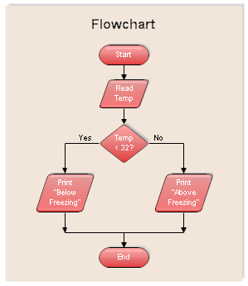
Example 1

Slide 5
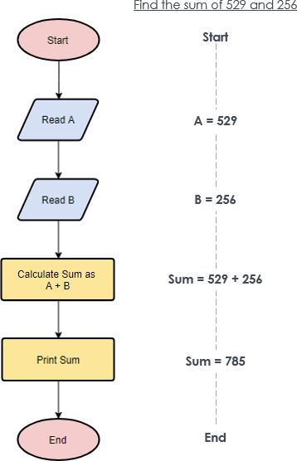
Example 2

Slide 6
Loop
A loop is a sequence of instruction s that is continually repeated until a condition p is reached
If p
No
Yes
Instruction s
i+1← i

Slide 7
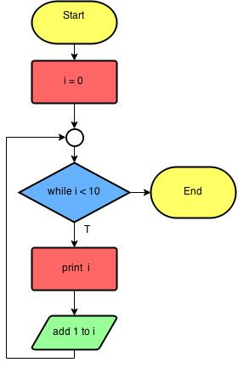
Example

Slide 8
Finding maximum of three numbers

Slide 9
Finding maximum of three numbers

Slide 10
Comparing to other languages
cross platform or single platform
single | cross
C# | Python
Swift | Java
F# | PHP
Asp | C

Slide 11
Comparing to other languages
Compiler or Interpreter
Inter | Comp
Python | C, C++
PHP | Java
JavaScript | Scala
R | C#

Slide 12


Comparing to other languages
Object-oriented programming (OOP)
OOP | OOP
HTML | Python
PHP5 | PHP6
C | C++
F# | Java

Slide 13
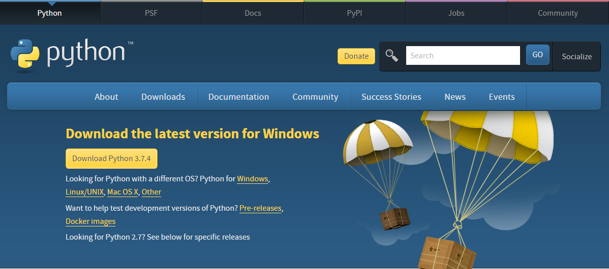
Install Python
www.python.org/downloads

Slide 14
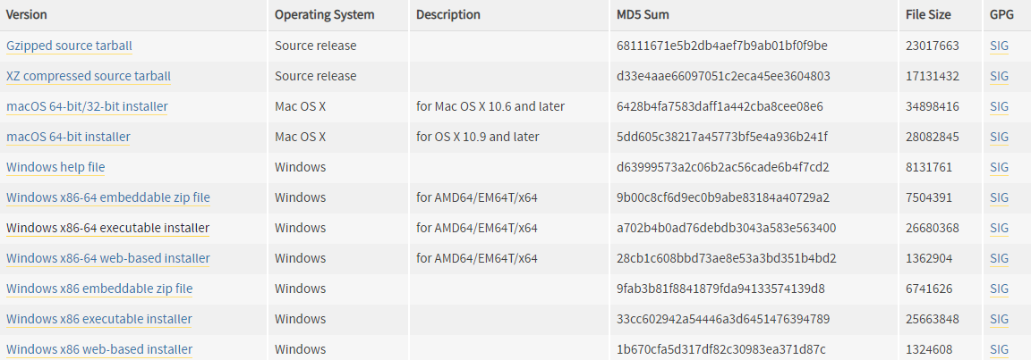
Install Python
Click on your selected version and download

Slide 15
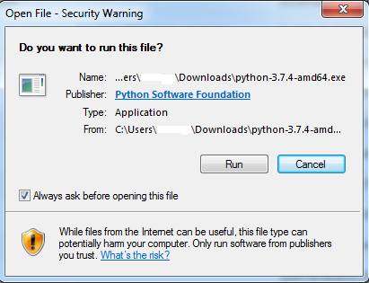
Install Python
Click “Run” on the installer tab

Slide 16
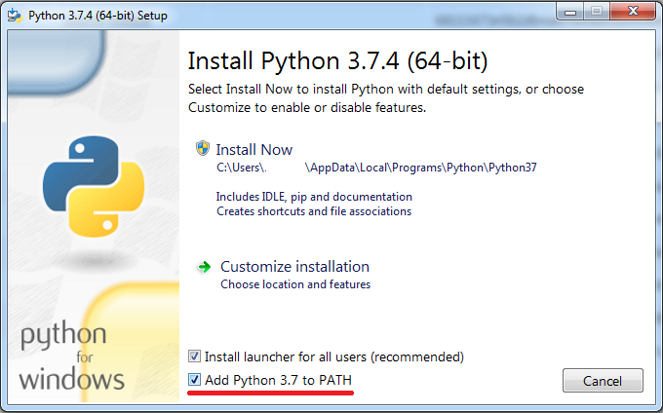
Install Python
Check the “Add Python 3.7 to PATH” box

Slide 17
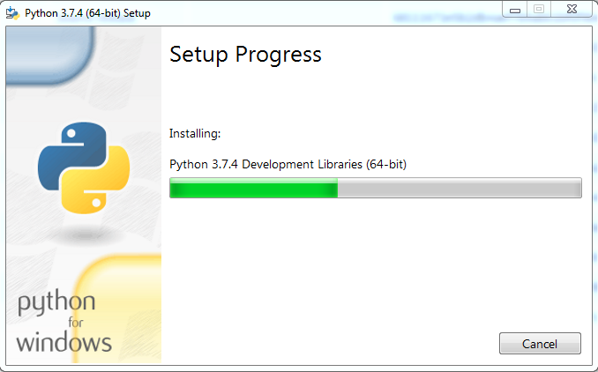
Install Python

Slide 18
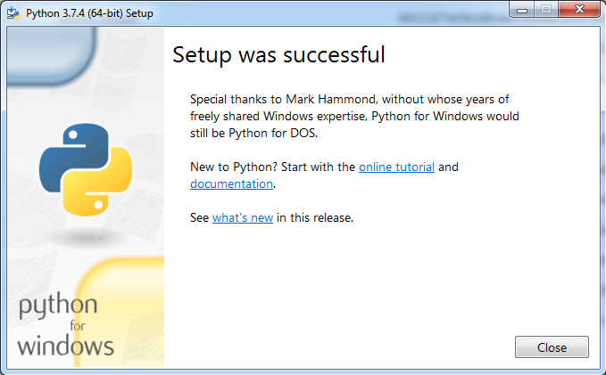
Install Python

